Slide 1
Lab on Cell-free Synthetic Biology - EE-490(j)
Fifth Week
07.10.2025

Slide 2
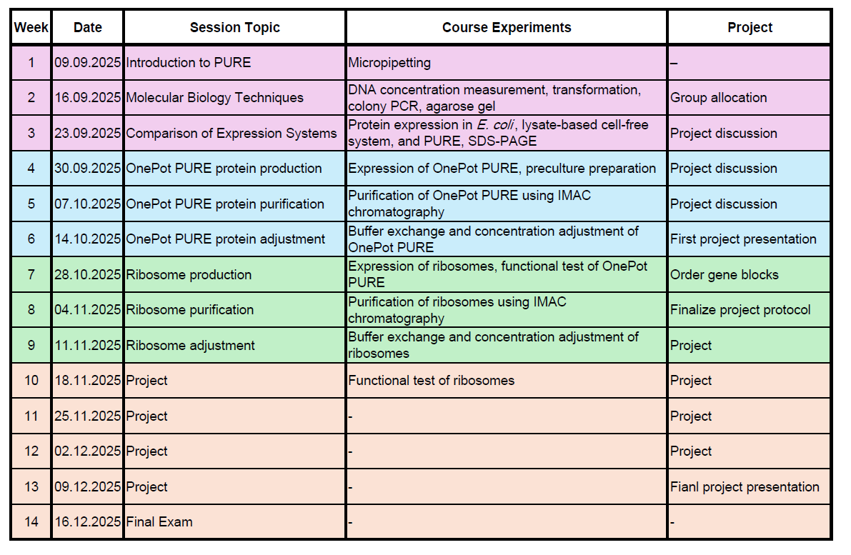
Course schedule

Slide 3
Today’s outline
Protein purification
Buffer Exchange and Concentration Adjustment

Slide 4
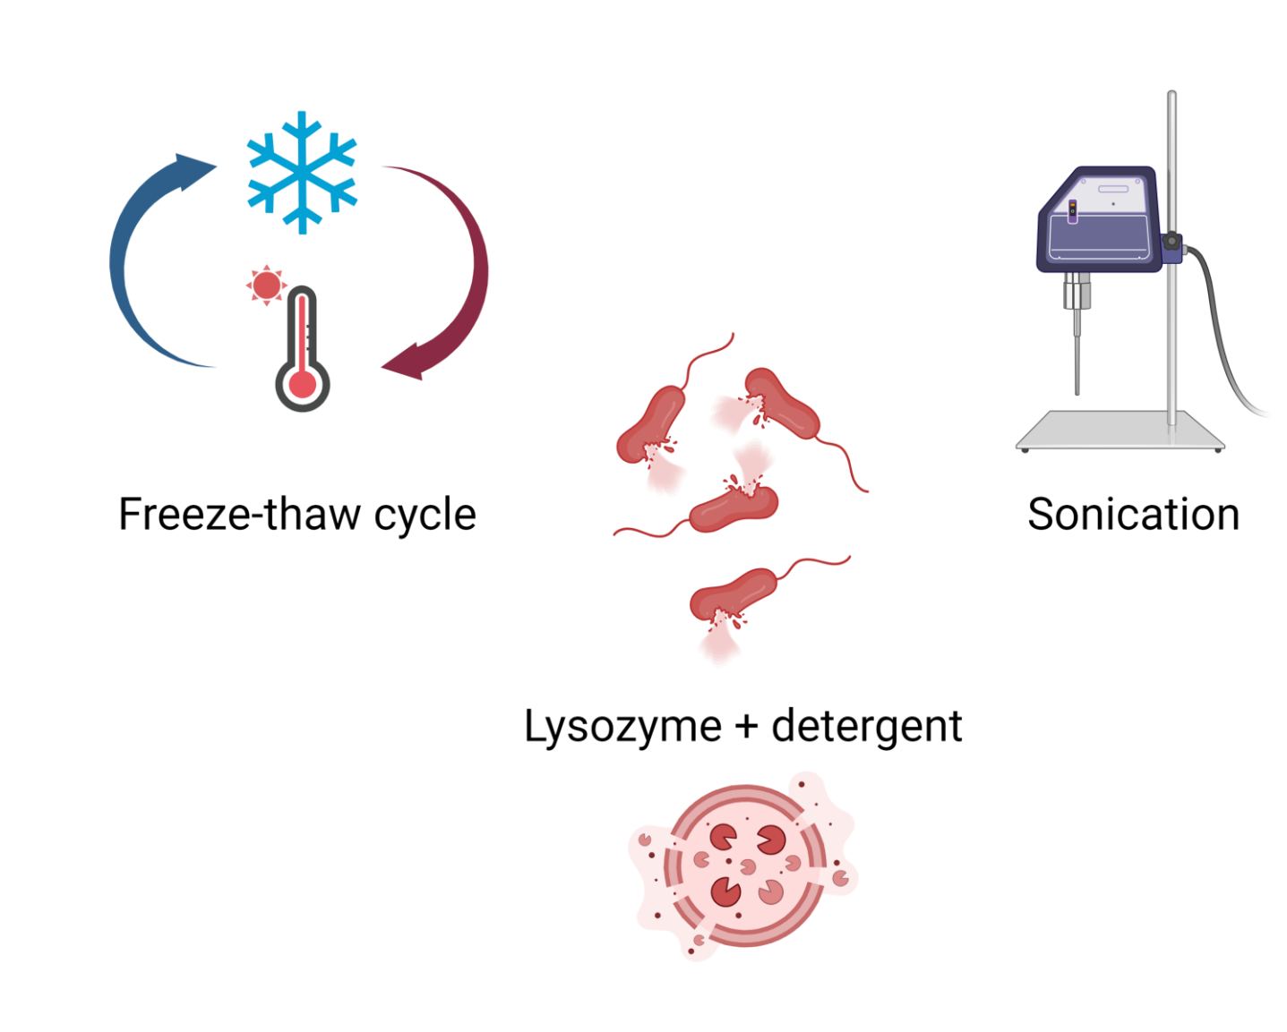
How to lyse the bacteria?

Slide 5
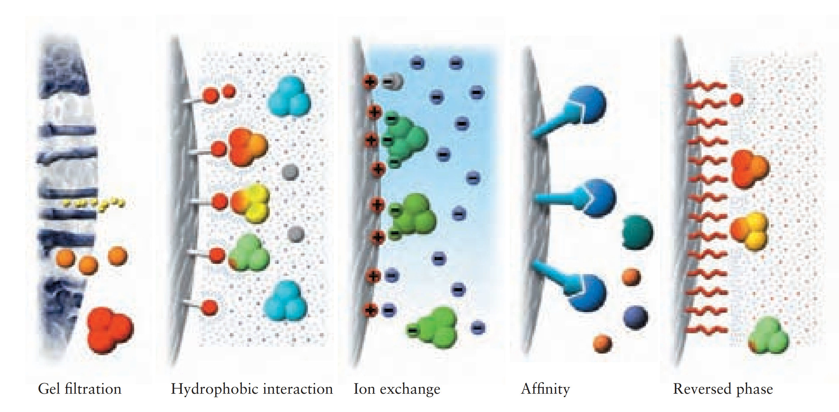
Separation principles in chromatographic purification
Technique
Property | Size | Hydrophobicity | Charge | Biorecognition (ligand specificity) | Hydrophobicity
GE Healthcare

Slide 6
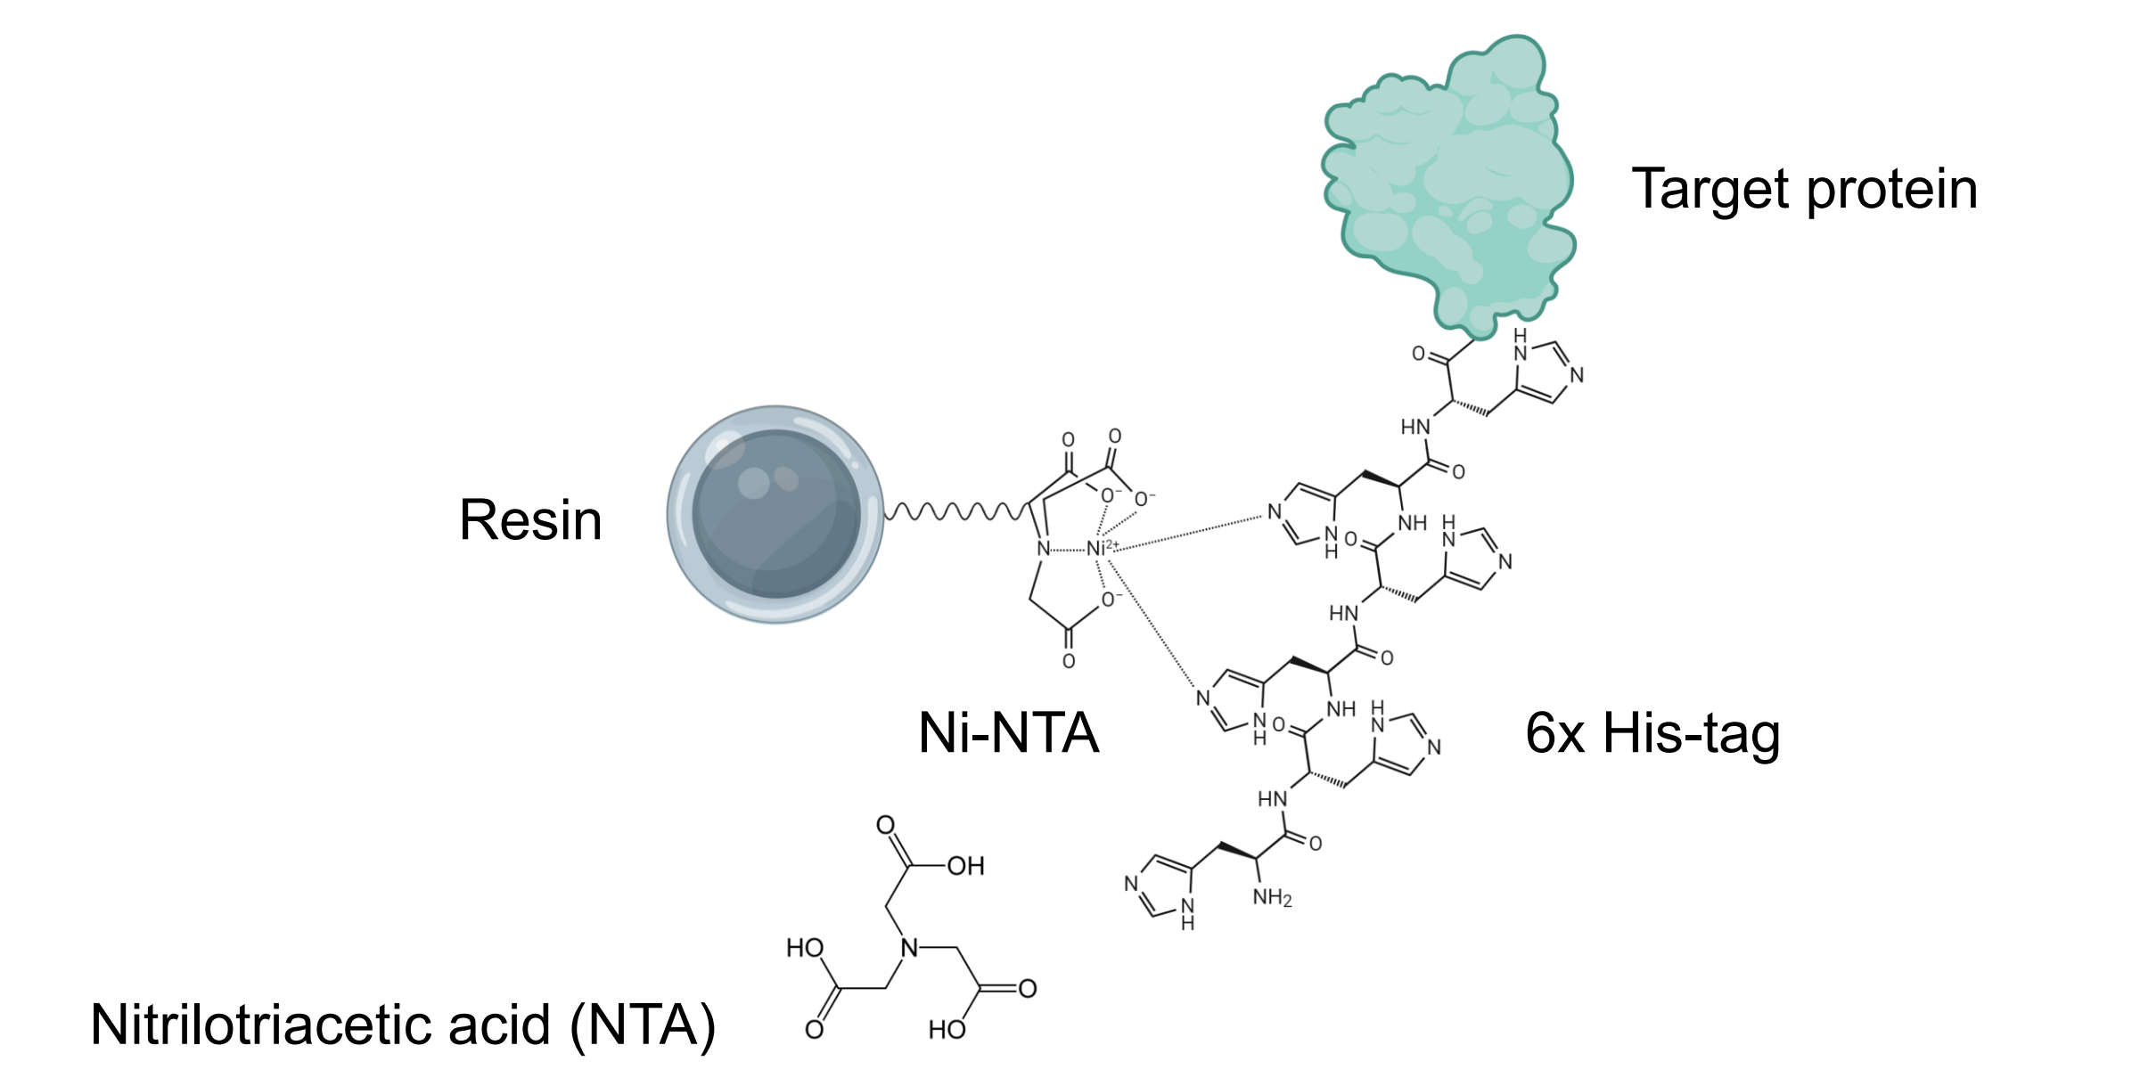
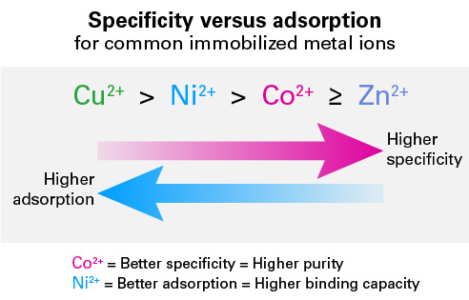
His-Tagged Protein Purification Using IMAC
IMAC: Immobilized Metal Affinity Chromatography

Slide 7
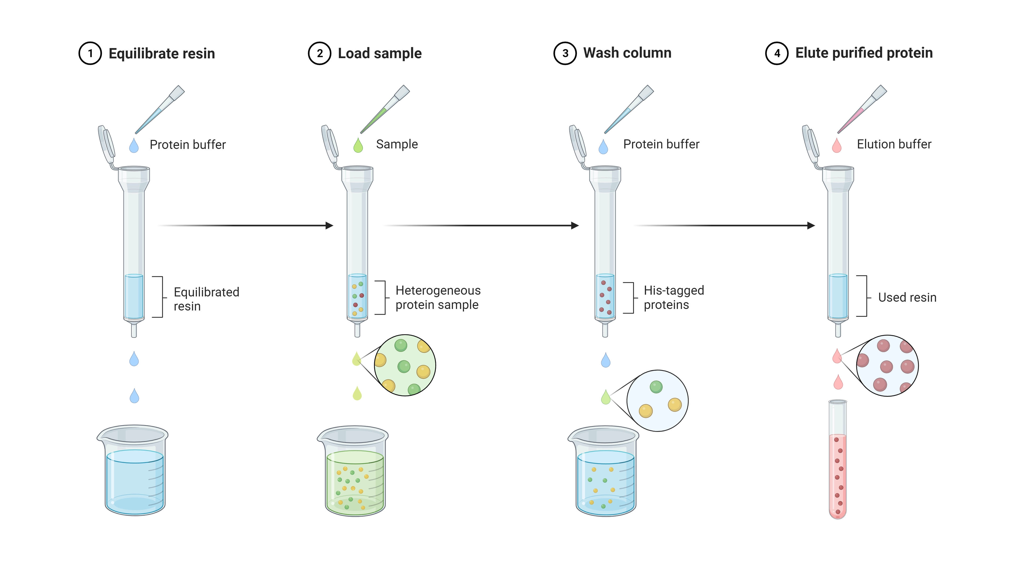
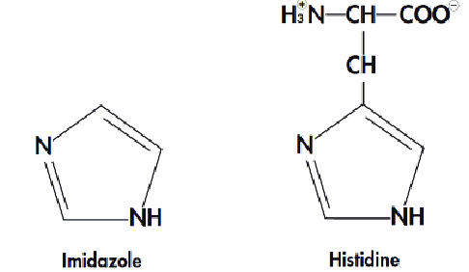
Steps of an affinity purification procedure
https://www.aatbio.com/catalog/affinity-purification

Slide 8
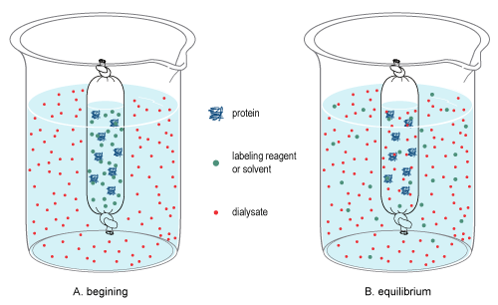
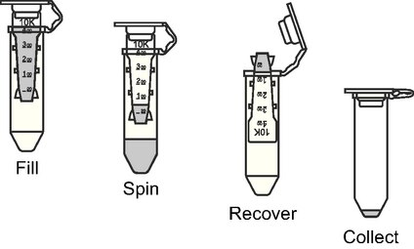
Buffer exchange
Dialysis
Ultrafiltration
Both for buffer exchange and concentration

